Slide 1
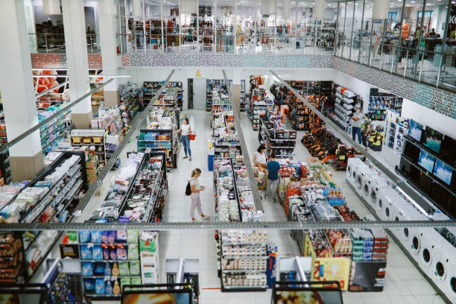
RETAIL STORE’S
ANALYTICS
2022(JAN) – 2024(JAN)

Slide 2
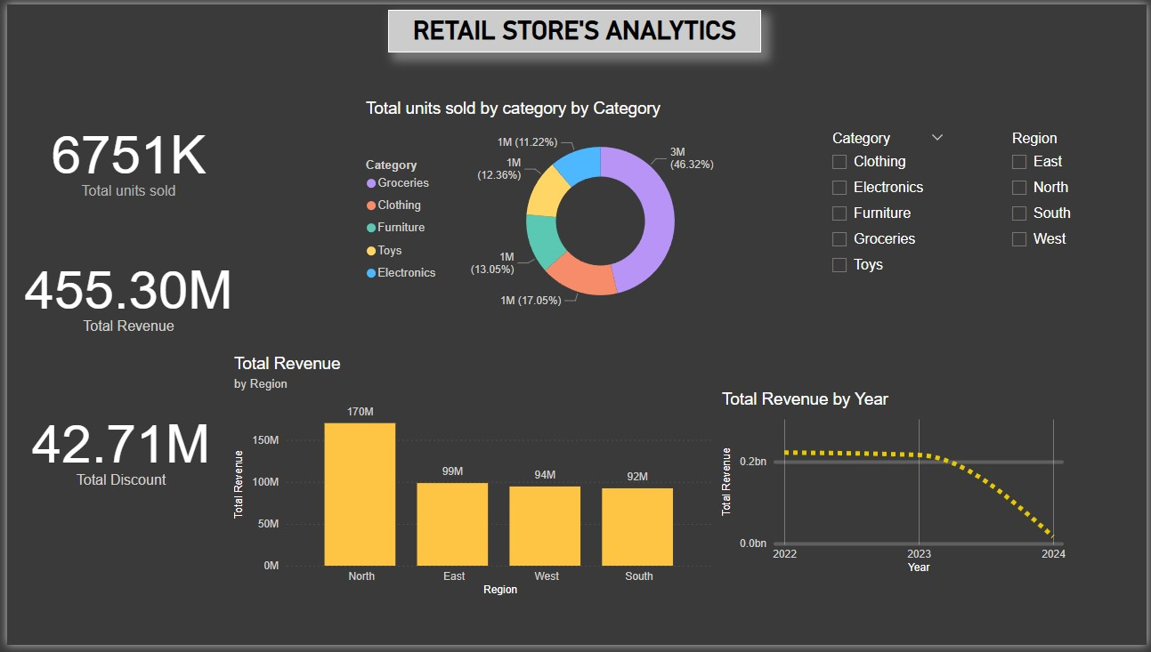
INSIGHTS
Groceries are the top-selling category, forming nearly half of total sales.
North region leads revenue-wise and can serve as a benchmark.
There’s a concerning decline in revenue in 2024, despite strong prior years.
Discounts given are moderate compared to revenue (approx. 9.4%).

Slide 3
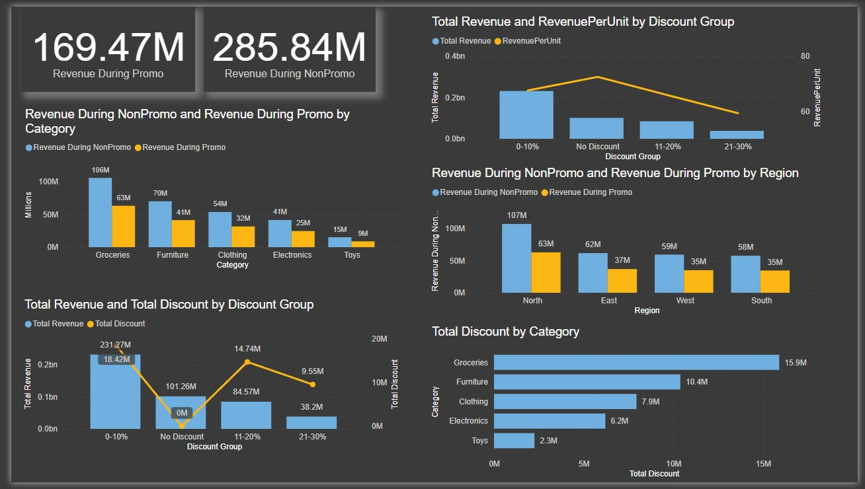
INSIGHTS
NonPromo strategies outperform Promo across all dimensions (category, region, and discount group).
Smaller discounts (0–10%) offer the best revenue-to-discount ratio.
North region and Groceries category are key contributors and should be focal points for sales optimization.
Deep discounts (21–30%) yield poor ROI and should be reconsidered.

Slide 4
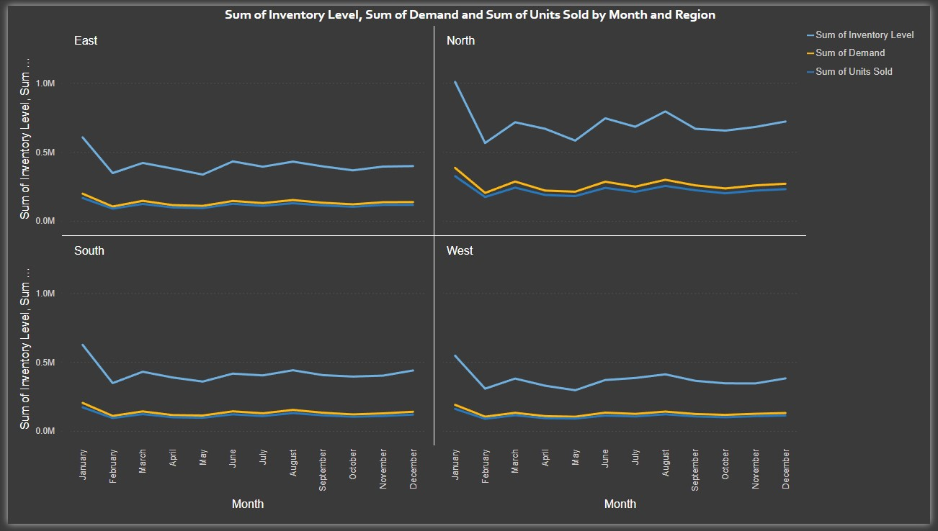
Inventory Optimization Needed in the North & West:
North has surplus inventory; optimize based on demand patterns.
West shows signs of excess inventory without matching demand — reduce or redistribute.
Forecasting Opportunities:
Demand and Units Sold tracking closely implies forecasting models are effective.
Use East and South as models for tighter inventory control in other regions.
February Dip Across Regions:
Anticipate seasonal dips early to avoid overstocking and adjust procurement schedules accordingly.
December Uptick:
All regions show a slight year-end rise in demand and inventory — likely holiday impact. Plan accordingly.

Slide 5
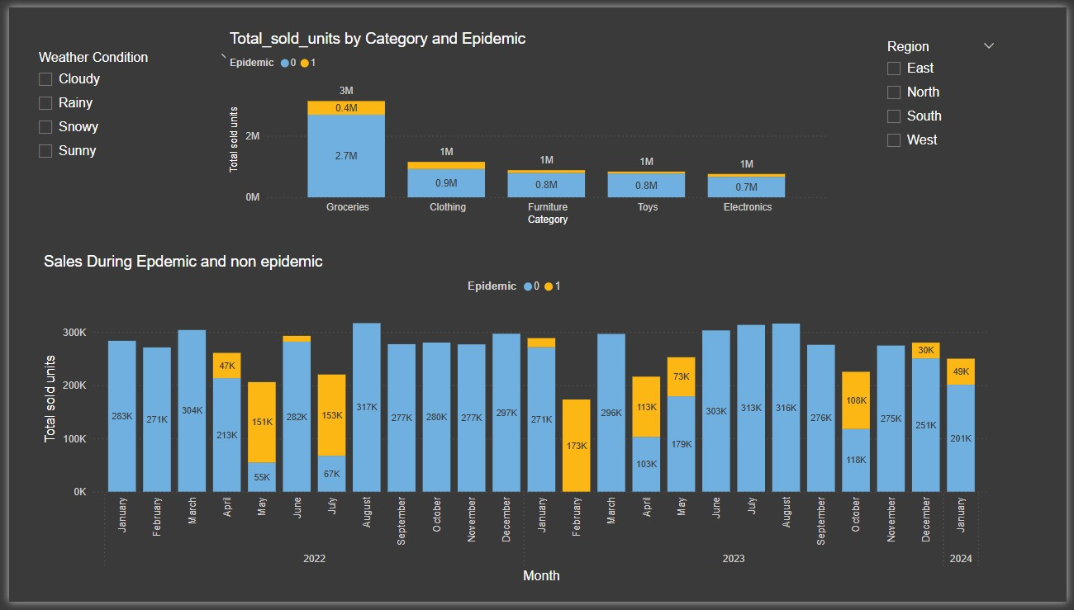

Slide 6
Category-wise Impact of Epidemic on Sales
Insights:
Groceries dominate total sales across both periods, but especially during non-epidemic times (90% share).
Electronics and Toys showed relatively resilient demand during epidemics compared to categories like Clothing.
Furniture and Toys maintained similar proportions in both conditions — possibly considered essential or home-focused during lockdown-like conditions.
Monthly Sales During Epidemic vs. Non-Epidemic Periods
Chart: Sales During Epidemic and Non-Epidemic (2022–2024)
📌 1. Epidemic Impact is Uneven by Category
Essential categories (like Groceries) maintain high sales even during epidemics.
Non-essential/discretionary categories (Clothing) experience sharper drops.
📌 2. Epidemic Months Create Sharp Drops in Sales
On average, epidemic periods reduce total monthly sales by ~30–60%.
Epidemic impact was most severe in early 2022 and early 2023, less impactful in late 2023.
📌 3. Resilience Opportunities
Electronics and Furniture had relatively stable demand, showing potential for e-commerce adaptation during crises.
Planning for inventory resilience in Groceries and Electronics is key for epidemic preparedness.

Slide 7
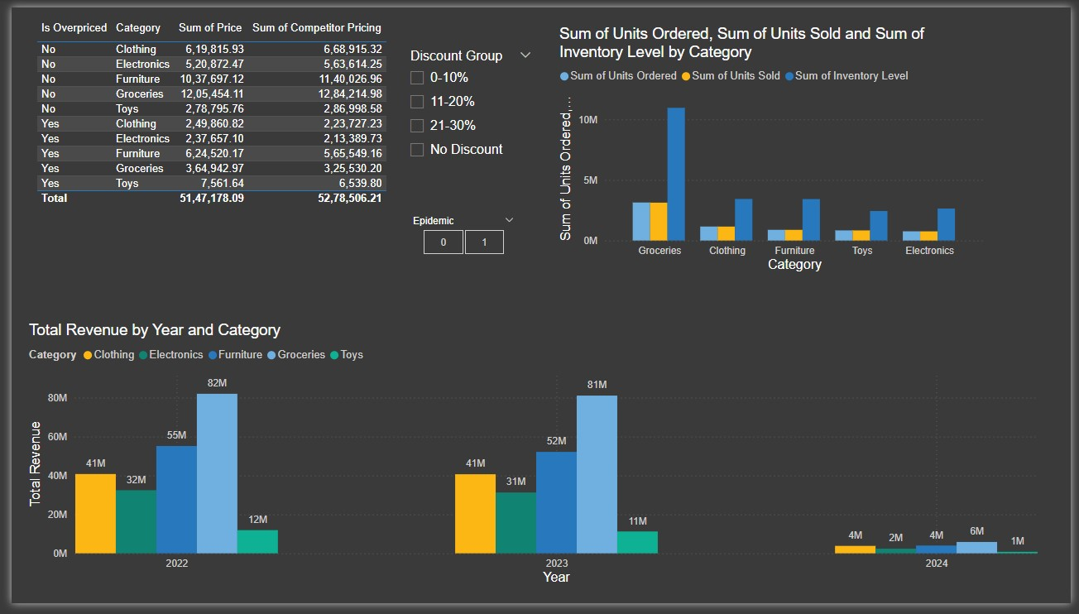
Insights:
Clothing, Electronics, Groceries, and Toys are overpriced compared to competitors, potentially affecting demand.
Toys have the lowest inventory and activity overall — signaling either low demand or intentional supply constraints.
Reassess pricing strategies for Clothing, Electronics, and Groceries where you're priced higher than competitors.

Slide 8
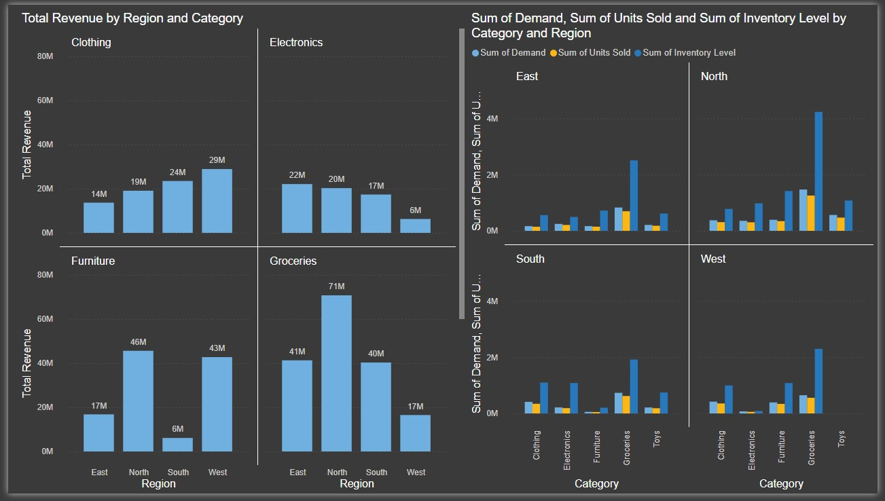
Strategic Recommendations by Region
📦 Inventory Optimization
North: Drastically reduce excess inventory, particularly for Furniture and Electronics.
West: Similar actions needed, especially since revenue is low despite high stock.
South and East: Reasonable balance — can serve as benchmarks for demand forecasting.
💰 Revenue Opportunity Regions
Clothing: Focus on expanding in East, where revenue lags.
Electronics: Reassess or scale back in West, increase push in East/North.
Furniture: Scale up presence in East/South, already strong in North/West.
Groceries: Prioritize North for marketing and logistics — it’s a major revenue contributor.

Slide 9
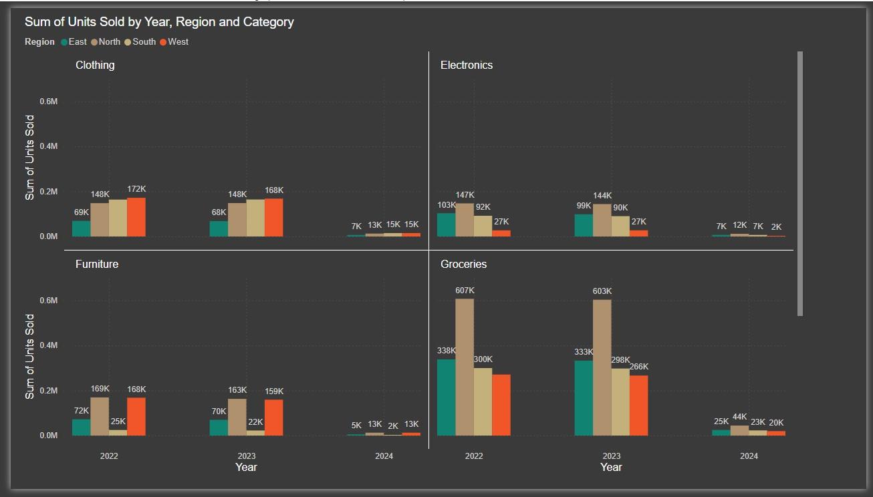
Sales Dropped Sharply in 2024 All product categories and regions saw a big fall in units sold—likely due to an epidemic or major disruption.
Groceries Lead the Market Groceries had the highest sales, especially in the North, making it the top-selling category overall.
North Region Performs Best The North region consistently had the highest sales across all product categories in 2022 and 2023.
Electronics and Furniture Struggle in Some Areas Electronics sold the least in the West, and Furniture sales were low in the South, showing regional weaknesses.

